Slide 1
Electromyography-Based Hand Gesture Recognition System for Upper Limb Amputees
GUIDED BY, PRESENTED BY,
SHERIN PETER. ANTONY JOSE.
ASST.PROFESSOR. COLLEGE OF ENGINEERING COLLEGE OF ENGINEERING POONJAR.
POONJAR . .

Slide 2
TABLE OF CONTENTS
ABSTRACT.
INTRODUCTION.
LITERTURE SURVEY.
WORKING.
BLOCK DIAGRAM.
FLOW CHART.
COMPARISON WITH EXISTING METHOD.
RESULT ANALYSIS.
APPLICATIONS.
FUTURE SCOPE.
CONCLUSION.
REFERENCES.

Slide 3
ABSTRACT
System present a low power,portable embeded platform for arm gesture recognition of amputees.
By EMG signals decoding.
ADS1298 as AFE which accure 8 channel EMG signals simultaneously.
For testing in RTE we use Transradial amputee,six activities for EMG PR experement,two cases in dsp processor.
(Future extration in DSP ,testing off- line) and (training and testing with dsp).

Slide 4
INTRODUCTION
EMG measure neuro muscular activities and motor control information for developing prosthetic.
EMG signals can be decoded using PR methods.
EMG electrodes applied on the residual limb.
Technique is utilized in the embedded platform.
LDA clssifier is employed.
ADS1298 AFE used as ADC.
ARM Cortex M4 used for DSP processing .

Slide 5
LITERATURE SURVEY
Sidharth Pancholi and Amit M.joshi -describe about EMG data acquistion technique in their paper.Portable EMG Data Acquisition Module for Upper limb amputees.
Daohui Zhang, Xingang Zhao, Jianda Han, and Yiwen Zhao-A Comparative Study on LDA Based EMG Pattern Recognition for Anthropomorphic Robotic Hand.
Sumit A.Raurale and Dr. Prashant N.Chatur -Identification of Real-time active hand movements EMG signals for control of Prosthesis.

Slide 6
WORKING
The proposed system consist of three parts.
ADS1298AFE and DSP processor.
Adjustable AG-AGCL electrode band for forearm.
Subjects are performed six activities including five grasping action.
Consider two cases to check maximum clasification accuracy.
Case two is proposed method.
Data is stored in ring buffer after digitalization
Classifier uses this for trainig and testing.

Slide 7
SYSTEM FOR EMG CLASIFICATION OF AMPUTEES

Slide 8
ADC
Full signal condition block on single chip(soc).
Signals amplified and processed.
8-channel low-noise PGA(programable Gain Amplifier).
8-channel high resolution 24bit ADC.
Measure biopotential signals.
Used in EMG,EEG appliction to test internallygenerated signal .
7

Slide 9
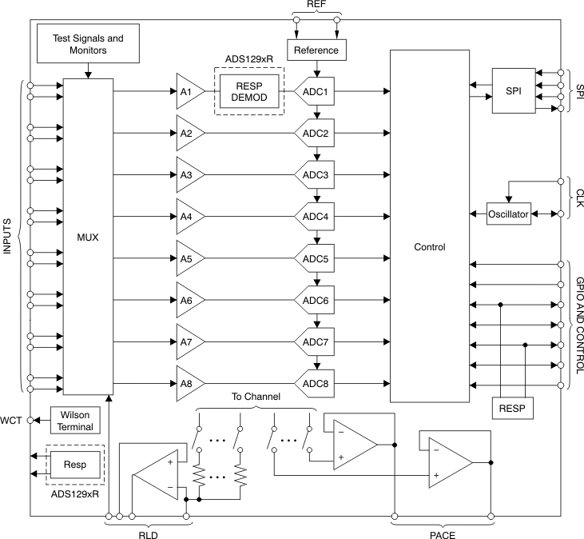
ADS 1298 AFE

Slide 10
DSP PROCESSOR
32 bit DSP Processor with ARM Cortex-M4 core.
Four time domain features and LDA classifiers.
To process the signal digitally.

Slide 11
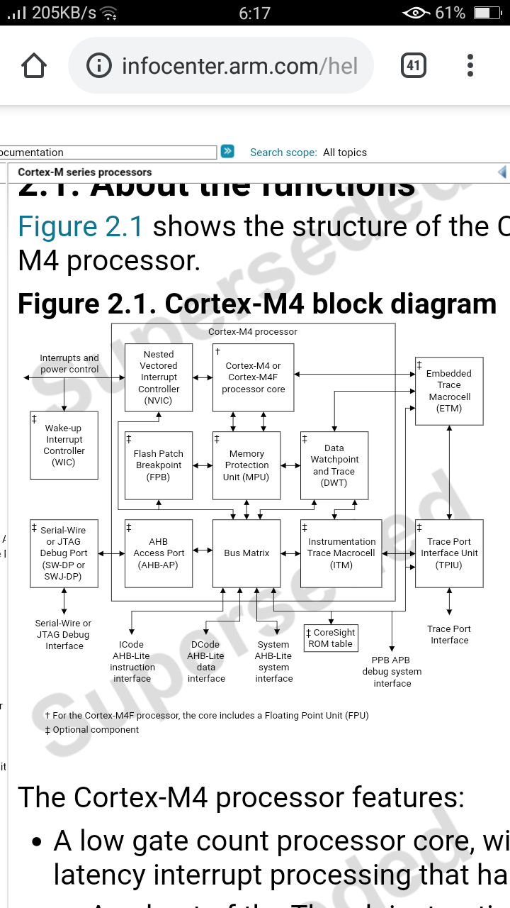
ARM CORTEX M4

Slide 12
SPECIFICATION OF AFE AND DSP
AFE
Number of channels power consumption input noise acquisiton frequency | 8 Differential input 15 mw 0.82 uv 1khz
DSP Processor
Core type Voltage Range OperatingFrequency Temperture Range | Arm Cortex M4 1.71 to 3.6 V 150 MHZ -40 to 85c

Slide 13
LDA CLASSIFIER ALGORITHM
Implementation of the LDA classifier algorithm for training in the DSP processor.

Slide 14
AG-AGCL ELECTRODE BAND
Used for clinical measurment.
EMG signal accquiring from skin.
AG-AGCL catches current eaisly.

Slide 15
ADJUSTABLE ARM BAND
Adjustable Ag-AgCl electrode band for the forearm

Slide 16
comparison with existing method
PARAMETER
System implemented Training Testing Amputee considered Clssifier Gesture state Number of gesture Number of channel Accuracy (mean) Power consumption
EXISTING METHOD
Computer Off-line On-line No SVM Hold 9 4 90% -
PROPOSED METHOD
Embedded on-line on-line Yes LDA Transient 6 8 94.14% 26.6mw

Slide 17
RESULT ANALYSIS
The result is analysed based on evaluation of two cases
Case one-the PR rate for the amputies is 92% represented by confusion matrices.
Case two- Tansradial amputee the mean clasification accuracy is 94.14% this system can work in the real-time environment.
From the analysis, the proposed system is capable to perform training and testing online the classification accuracy also improved over the existing system .

Slide 18
CASE ONE
SUB | SUBECT TYPE | CLASSFICATION ACCURACY IN %
Sub 1 Sub 2 Sub 3 Sub 4 | Healthy Healthy Healthy Amputee | 97.6% 94.5% 97.5% 92.0%
CASE TWO
ACTIVITIE | ACT 1 | ACT 2 | ACT 3 | ACT 4 | ACT 5 | ACT 6 | AVG
Sub 1 Sub 2 Sub 3 Sub 4 (amp.) | 100 100 100 100 | 100 100 100 100 | 86.6 96.3 86.6 90 | 93.3 96.6 90 86.6 | 90 93.3 90 93.3 | 100 100 93.3 90 | 94.98 97.75 92.20 91.65

Slide 19
ACTIVITIES PERFORMED BY THE SUBJECT
Activities performed by the subjects including cylindrical and spherical grasp: (a) (act1(rest)), (b) (act 2), (c) (act 3), (d) (act 4), (e) (act 5), and (f) (act 6).

Slide 20
APPLICATIONS
EMG signal pattern recognisation(PR) is used for prosthetic development in biomedical industries
Low cost and portable prosthtic can developed for amputees.

Slide 21
future scope
Human-machine interaction is established in medical diagnostics.
AI&Machine learning techniques can be easily employed in prosthetic development.
Prosthetics of any body parts can be artificially employed with low cost and accuraccy with better eficiency.

Slide 22
CONCLUSION
Arm gesture recognition system is presented for the amputees.
This system can be utilized for myoelectric prosthetic control with above 91% of accuracy.
LDA classifier are incorporated within the DSP processor. grasping motion can decode in 75 ms .
This system has light weight 17.5 g and battery power support up to 40 Hrs.And low-power applications.

Slide 23
REFERENCES
[1] S. Benatti et al., “A versatile embedded platform for EMG acquisition and gesturerecognition,” TBioCAS, vol. 9, no. 5, pp. 620–630, 2015.
[2] S. Lee, M.-O. Kim, T. Kang, J. Park, and Y. Choi, “Knit band sensor for myoelectriccontrol of surface EMG-based prosthetic hand,” IEEE Sensors J., vol. 18, no. 20,pp. 8578–8586, Oct. 2018.
[3] S. Pancholi and R. Agarwal “Development of low cost EMG data acquisition systemfor Arm Activities Recognition,” in Proc. IEEE Int. Conf. Adv. Comput., Commun.Inform., 2016, pp. 2465–2469.

Slide 24
THANK YOU

